Slide 1
Introduction to
Cybersecurity
David J. Malan
malan@harvard.edu

Slide 2
Souvenir Photo

Slide 3
Introduction to
Cybersecurity
David J. Malan
malan@harvard.edu
Notes:
Alright, this is CS50's introduction to cybersecurity, my name is David Malan and this week let's focus on preserving privacy. Just because your information can be kept secure doesn't mean you want others to have access to it at all.

Slide 4
Preserving Privacy

Slide 5
Web Browsing History

Slide 6
Logs

Slide 7
IP Address

Slide 8
log_format combined '$remote_addr - $remote_user [$time_local] '
'"$request" $status $body_bytes_sent '
'"$http_referer" "$http_user_agent"';
Notes:
https://nginx.org/en/docs/http/ngx_http_log_module.html

Slide 9
log_format combined '$remote_addr - $remote_user [$time_local] '
'"$request" $status $body_bytes_sent '
'"$http_referer" "$http_user_agent"';

Slide 10
HTTP Headers

Slide 11
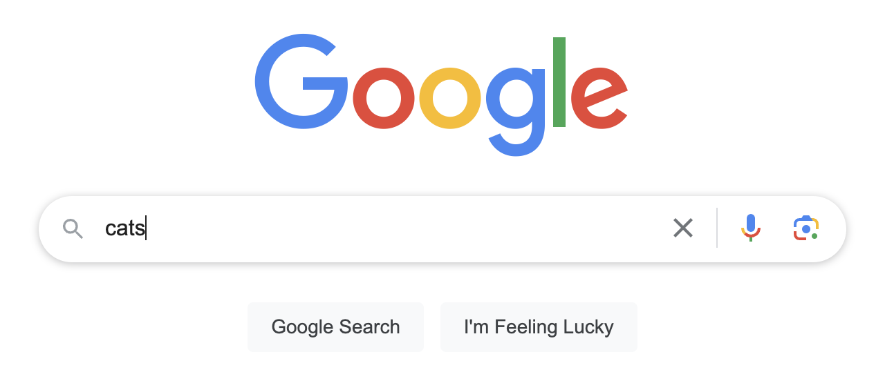

Slide 12
<a href="https://example.com">cats</a>

Slide 13
Referer: https://www.google.com/search?q=cats

Slide 14
Referer: https://www.google.com/

Slide 16
<meta name="referrer" content="origin">

Slide 17
<meta name="referrer" content="none">

Slide 18
Referrer-Policy: origin

Slide 19
Referrer-Policy: no-referrer

Slide 20
Fingerprinting

Slide 21
User-Agent

Slide 22
Mozilla/5.0 (Linux; {Android Version}; {Build Tag etc.})
AppleWebKit/{WebKit Rev} (KHTML, like Gecko)
Chrome/{Chrome Rev} Mobile Safari/{WebKit Rev}
Notes:
https://developer.chrome.com/docs/multidevice/user-agent/

Slide 23
break

Slide 24
Session Cookies

Slide 25
HTTP/3 200
Set-Cookie: session=1234abcd

Slide 26
GET / HTTP/3
Cookie: session=1234abcd

Slide 27
Tracking Cookies

Slide 28
Set-Cookie: _ga=GA1.2.0123456789.0; max-age=63072000
Notes:
https://policies.google.com/technologies/cookies?hl=en-US
https://developer.mozilla.org/en-US/docs/Web/HTTP/Headers/Set-Cookie#examples

Slide 29
Tracking Parameters

Slide 30
https://example.com/ad_engagement?click_id=YmVhODI1MmZmNGU4&campaign_id=23
Notes:
https://www.macrumors.com/2023/06/17/safari-link-tracking-protection/

Slide 31
https://example.com/ad_engagement?click_id=YmVhODI1MmZmNGU4&campaign_id=23
Notes:
https://www.macrumors.com/2023/06/17/safari-link-tracking-protection/

Slide 32
https://example.com/ad_engagement?campaign_id=23
Notes:
https://www.macrumors.com/2023/06/17/safari-link-tracking-protection/

Slide 33
Third-Party Cookies

Slide 34
<!DOCTYPE html>
<html>
<head>
<title>Harvard</title>
</head>
<body>
<img src="https://example.com/ad.gif">
</body>
</html>

Slide 35
<!DOCTYPE html>
<html>
<head>
<title>Yale</title>
</head>
<body>
<img src="https://example.com/ad.gif">
</body>
</html>

Slide 36
<!DOCTYPE html>
<html>
<head>
<title>Stanford</title>
</head>
<body>
<img src="https://example.com/ad.gif">
</body>
</html>

Slide 37
GET /ad.gif HTTP/3
Host: example.com
Referer: https://harvard.edu/

Slide 38
HTTP/3 200
Set-Cookie: id=1234abcd; max-age=31536000

Slide 39
GET /ad.gif HTTP/3
Cookie: id=1234abcd
Host: example.com
Referer: https://yale.edu/

Slide 40
GET /ad.gif HTTP/3
Cookie: id=1234abcd
Host: example.com
Referer: https://stanford.edu/

Slide 41
Private Browsing

Slide 42
Supercookies

Slide 43
GET / HTTP/3
Host: example.com

Slide 44
GET / HTTP/3
Host: example.com
Cookie: id=1234abcd

Slide 45
DNS

Slide 46
DNS over HTTPS (DoH)

Slide 47
DNS over TLS (DoT)

Slide 48
Virtual Private Network
(VPN)

Slide 49
Tor

Slide 50
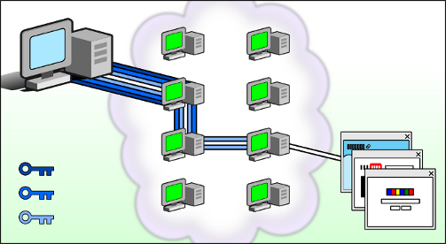
Notes:
https://tb-manual.torproject.org/about/

Slide 51
Permissions
Notes:
camera, mic, contacts, GPS

Slide 52
Location-Based Services

Slide 53
Introduction to
Cybersecurity
David J. Malan
malan@harvard.edu
Notes:
Accounts, Data, Systems, Software; Privacy

